Slide 1

FORM 2 STEM PROJECT
Chan Tsz Him ( 4 )
Lemuel Ma ( 18 )
Ben Liu ( 17 )
Tam Yu Ji ( 24 )

Slide 2


Slide 3
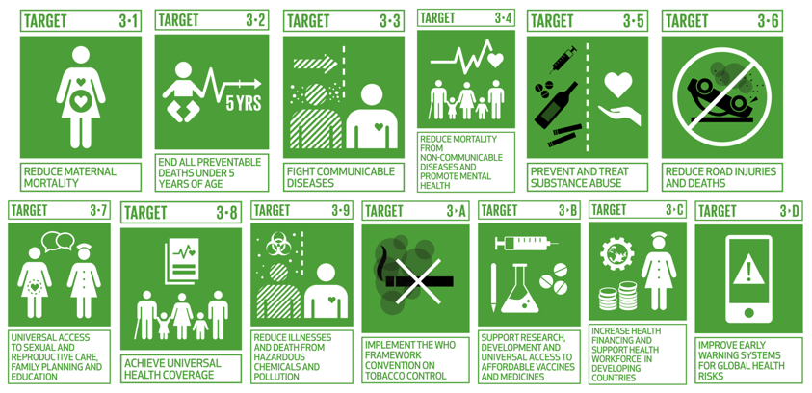

Slide 4
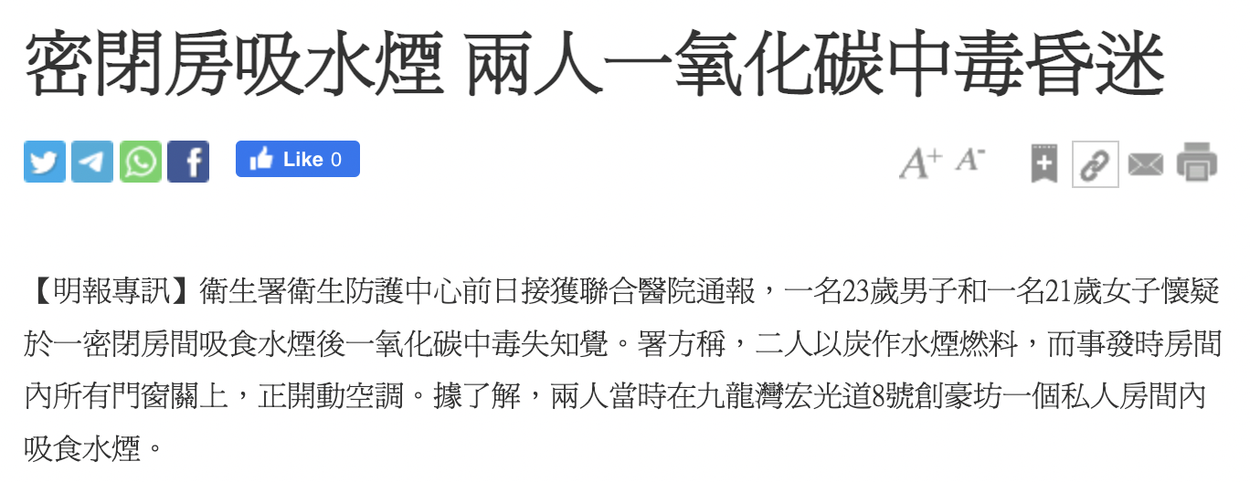
Problem for achieving the SDG
News from 19/02/2023
Every year, at least 430 people die in the U.S. from accidental CO poisoning.
Source : Ming Pao rb.gy/rzitmn

Slide 5


Slide 6



Slide 7
Air Monitoring System
Normal Situation
Keeps on checking the value of the environment
Report data to panel
GAS LEAKAGE
Send unusual data to online panel
Send unusual data to mobile phones connected
Turn on LED lights and emit sound

Slide 8
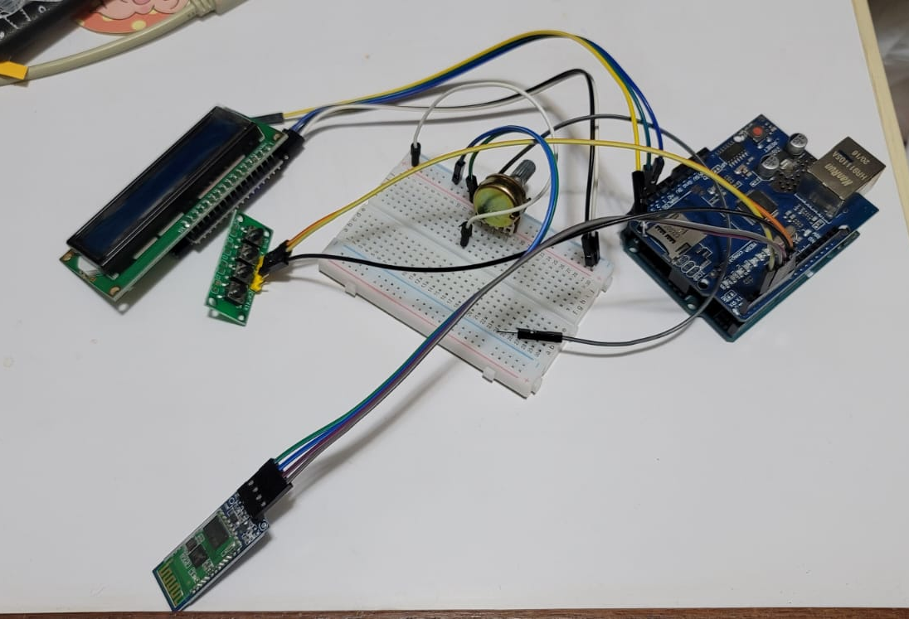
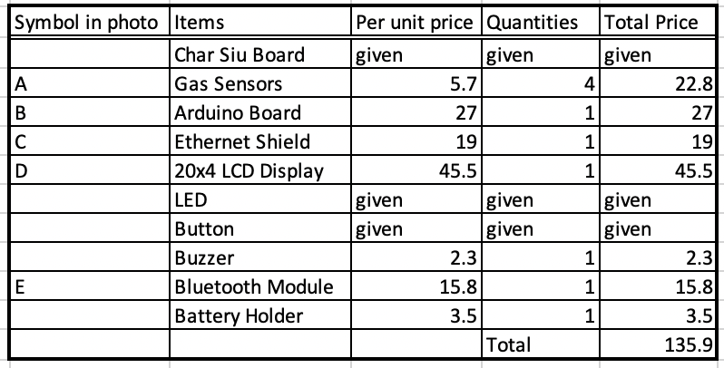
Materials
Replacement of A
for tests
C
D
B
E

Slide 9
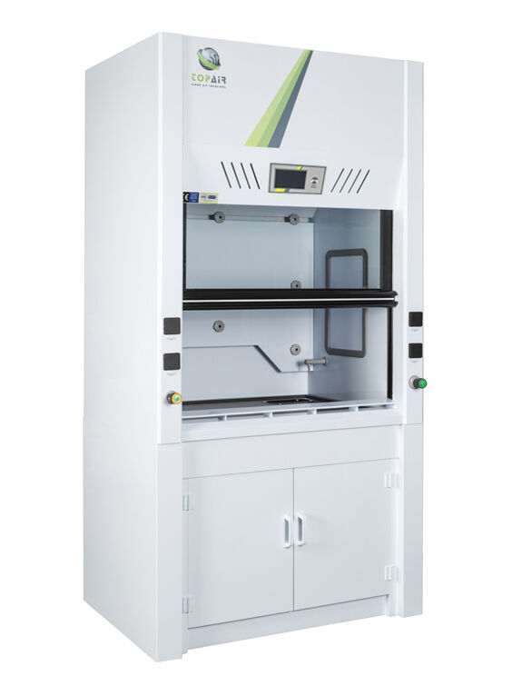
Extension of the Project
Fume Cupboard
Update the data using the internet wirelessly
Test for presence of gas in experiment

